Slide 1


TITLE OF THE PROJECT
OPTIMIZATION IN SUPPLY CHAIN MANAGEMENT

Slide 2


PROJECT LEADERSHIP
Sharat Manikonda
Director at Innodatatics and Sponsor
linkedin.com/in/sharat-chandra
MENTOR BY:
SRISHTI PATHAK
SAMYAK SABANNAWAR
DONE BY:
SANTHOSH.K

Slide 3
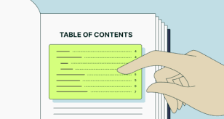

CONTENTS
Business objective & Constraint
Project Architecture
Business Problem
CRISP ML(q)
Data Collection
Data Understanding
Data Information
Data Dictionary
System Requirements
Exploratory Data Analysis(Before, After)
Data Preprocessing
Data Visualization
Challenges
Future Scope
Thank you
Notes:
Change

Slide 4


BUSINESS OBJECTIVE & CONSTRAINT
Business objective:
Minimize the volatility in inventory stock
Business constraint:
Minimize the human intervention

Slide 5
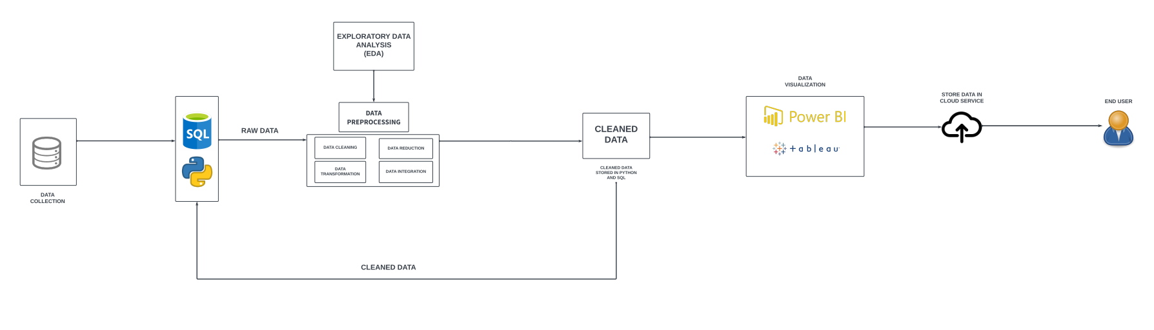
PROJECT OVERVIEW AND SCOPE
PROJECT ARCHITECTURE

Slide 6

BUSINESS PROBLEM
No of pallets to be stored in the inventory for shipping for different customers is very volatile leading to understocking and overstocking

Slide 7
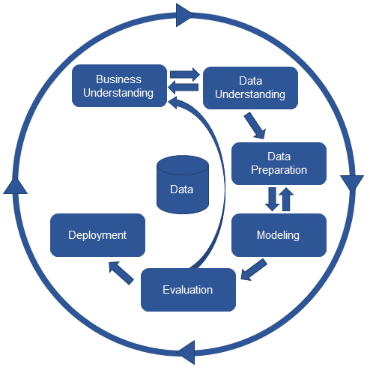
There are six stages of CRISP-ML(Q) Methodology
1.Business and data understanding
2.Data preparation
3.model building
4.Model evaluation
5.Model deployment
6.Monitoring and maintenance
CRISP ML-Q METHODOLOGY

Slide 8

DATA COLLECTION
Data collection is the process of gathering and capturing information from various sources to be used for analysis, research, or decision-making. The quality and reliability of the collected data play a crucial role in the outcomes of any analysis or project.
FILE READING
Use libraries like PANDAS for reading data from files such as CSV, Excl, JSON, etc.
CODE
import pandas as pd
import numpy as np
df = pd.read_csv(r"C:\Users\MY PC\Desktop\360 PROJECT\pallet_Masked_fulldata.csv")
print(df)

Slide 9
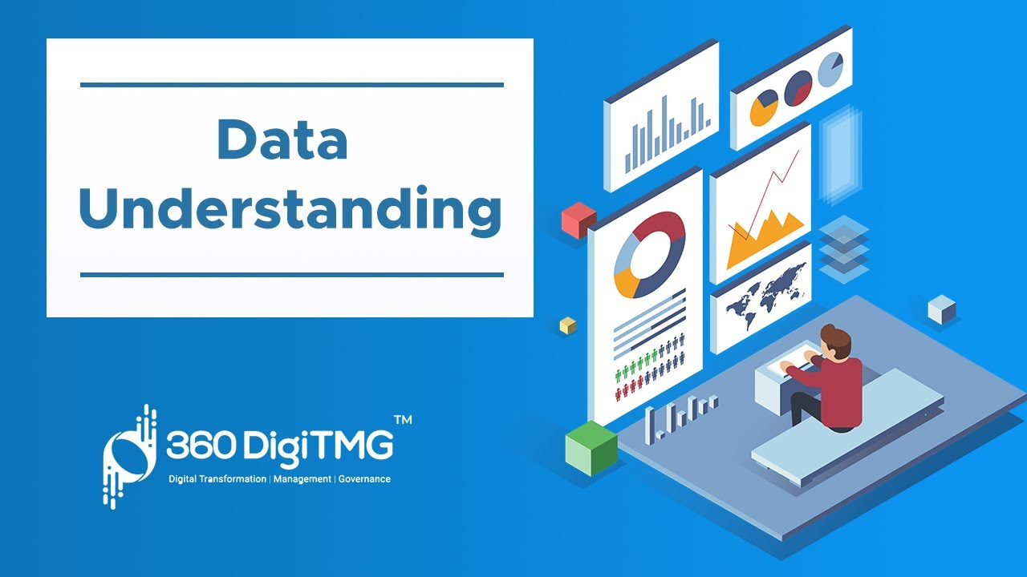
DATA UNDERSTANDING
Data understanding is a critical phase in the data analysis process. It involves exploring and gaining insights into the characteristics, structure, and content of the dataset. This phase helps analysts and data scientists become familiar with the data, identify patterns, and make informed decisions about how to proceed with analysis.
TYPES OF DATA UNDERSTANDING:
EXPLORATORY DATA ANALYSIS
DATA CLEANING
DATA VISUALIZATION

Slide 10
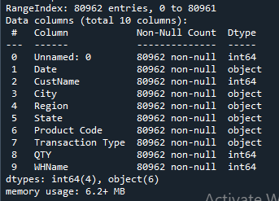
DATA INFORMATION
"Data information" is a broad term that can refer to various aspects of data
In our dataset major of the data types were INTERGER and OBJECT .
And there were no null values present in the dataset
The total number of data’s were 80962

Slide 11
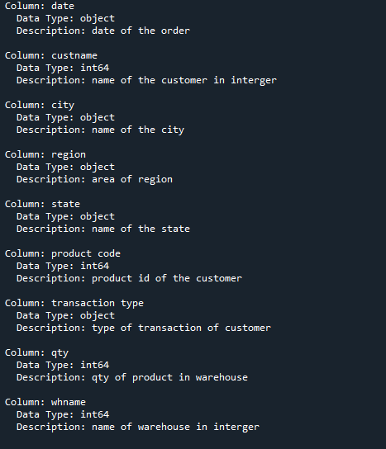
DATA DICTIONARY
In Python, a data dictionary is a way to document and describe the contents of a dataset. It typically includes information about each variable or column, such as its name, data type, description, and any other relevant details. Creating a data dictionary helps maintain clarity and consistency when working with datasets.

Slide 12
SYSTEM REQUIREMENTS
OPERATING SYSTEM: Windows 11 pro
RAM: Corsair Vengence 8gb(*2)
PROCESSOR: Ryzen 5500
GRAPHICS CARD: Gigabyte 1660 Super
SSD: WD 500gb
MOTHERBOARD: Gigabyte b450 dsh3 wifi
SMPS: DeepCool 550w

Slide 13
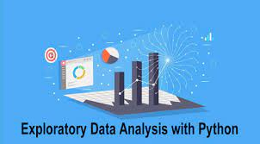
EXPLORATORY DATA ANALYSIS [EDA]
Exploratory Data Analysis (EDA) is a crucial step in the data analysis process. It involves examining and understanding the characteristics of a dataset to uncover patterns, identify relationships, and gather insights that can inform subsequent analyses. EDA is often performed using statistical graphics, summary statistics, and other techniques.
EDA steps occurred in our dataset are:
INTIAL EXPLORATION
UNIVARIATE ANALYSIS
BIVARIATE ANALYSIS
MULTIVARIATE ANALYSIS
OUTLIER DETECTION
MISSING VALUES
IDENTIFY AND REMOVE DUPLICATES
Notes:
EDA is used for seeing what the data can tell us before the modeling task.
Change

Slide 14
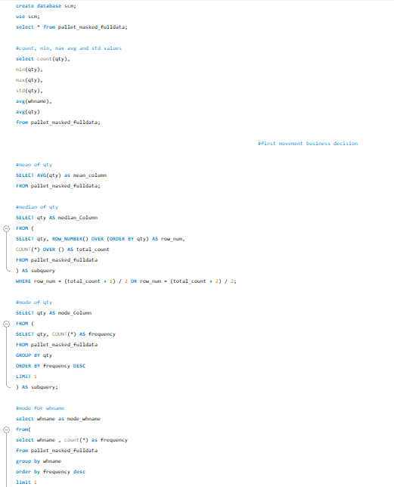
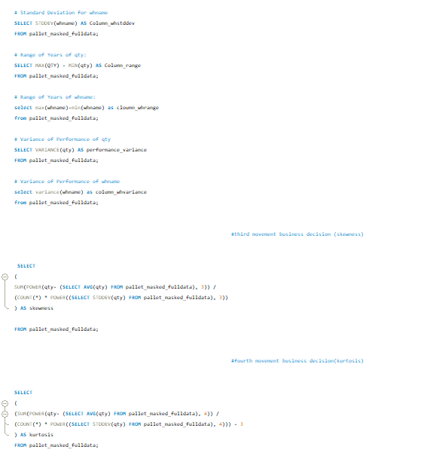
EXPLORATORY DATA ANALYSIS [EDA]
Sql coding
Notes:
EDA is used for seeing what the data can tell us before the modeling task.
Change

Slide 15
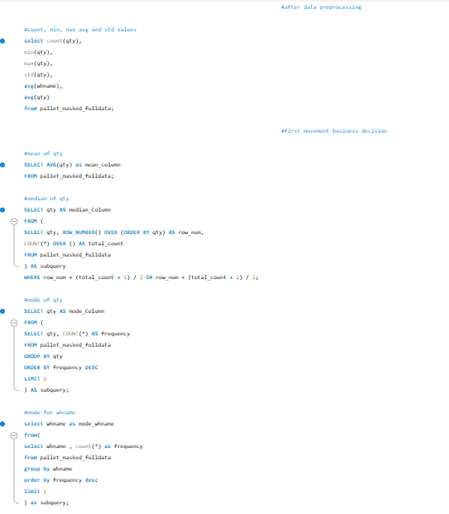
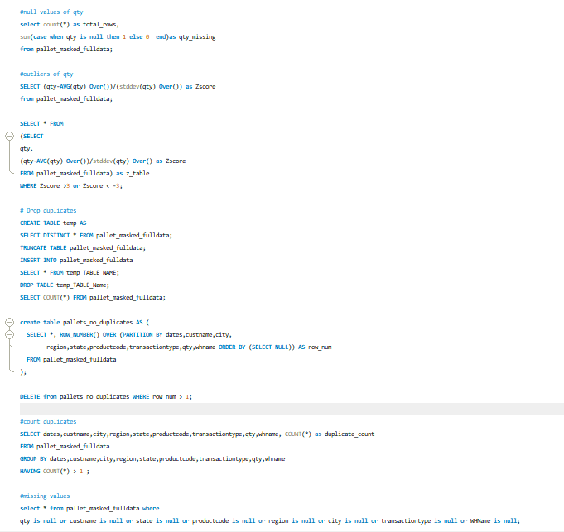
EXPLORATORY DATA ANALYSIS [EDA]
Sql coding
Notes:
EDA is used for seeing what the data can tell us before the modeling task.
Change

Slide 16
BEFORE EDA
STATISTICAL INSIGHTS
BUSINESS INSIGHTS
CATEGORY | VALUES
COLUMNS | 9
ROWS | 80962
DATE | 1608
CUSTNAME | 4183
CITY | 696
REGION | 4
STATE | 33
PRODUCT CODE | 70
TRANSACTION TYPE | 2
There were multiple duplicate values in the table
There were a column named as unknown
So the insight are difficult to find
There were a repetition of data in the table
There are various forms of data types
The custname were represented in integer
The whname were represented in integer
The qty were represented in integer
There were four regions and two transaction type
The eda process and the data pre processing process cleans the data and gives the valuable insights
Notes:
EDA is used for seeing what the data can tell us before the modeling task.
Change

Slide 17
BEFORE EDA
STATISTICAL INSIGHTS
QTY | 961
WHNAME | 87
FIRST MOVEMENT BUSINESS DECISION
MEAN | 42.965
MEDAIN | 100
MODE | 100
SECOND MOVEMENT BUSINESS DECISION
STANDARD DEVIATION | 212.7005
RANGE | 1140
VARIANCE | 45241.503
THIRD MOVEMENT BUSINESS DECISION
SKEWNESS | -0.21399
FOURTH MOVEMENT BUSINESS DECISION
KURTOSIS | -0.9177
DATA PREPROCESSING
NULL VALUES | NO NULL VALUES
MISSING VALUES | NO MISSING VALUES
OUTLIERS | NO OUTLIERS
DUPLICATES | 11291
Notes:
EDA is used for seeing what the data can tell us before the modeling task.
Change

Slide 18
AFTER EDA
STATISTICAL INSIGHTS
BUSINESS INSIGHTS
CATEGORY | VALUES
COLUMNS | 9
ROWS | 64024
DATE | 1608
CUSTNAME | 4183
CITY | 696
REGION | 4
STATE | 33
PRODUCT CODE | 70
TRANSACTION TYPE | 2
Customer ordered each product atleast 50 unit and max 600 units
Most ordered product is A010000035 so if we maintain more units of this product would be benefit
So, maintaining each product 100 or 120 units would be better in inventory room
Customer name 11 is the most frequent customer
The city ahmedabad is the most frequent city
The state maharastra the most frequent state
The region north is the most frequent region
Notes:
EDA is used for seeing what the data can tell us before the modeling task.
Change

Slide 19
AFTER EDA
STATISTICAL INSIGHTS
QTY | 961
WHNAME | 87
FIRST MOVEMENT BUSINESS DECISION
MEAN | 43.015
MEDAIN | 100
MODE | 100
SECOND MOVEMENT BUSINESS DECISION
STANDARD DEVIATION | 211.016
RANGE | 1140
VARIANCE | 44528.051
THIRD MOVEMENT BUSINESS DECISION
SKEWNESS | -0.1729
FOURTH MOVEMENT BUSINESS DECISION
KURTOSIS | -0.8636
DATA PREPROCESSING
NULL VALUES | NO NULL VALUES
MISSING VALUES | NO MISSING VALUES
OUTLIERS | NO OUTLIERS
DUPLICATES | NO DUPLICATES
Notes:
EDA is used for seeing what the data can tell us before the modeling task.
Change

Slide 20
AFTER EDA
BUSINESS INSIGHTS
The most frequent transaction type is allot
Warehouse 1009 is the most frequent warehouse
The duplicates were also removed
There were no missing,null, or outlier values
We can further vizualize the data to understand better
Hence from this data preprocessing process ,
We can maintain the stock of the product in each warehouse according to the customer
We can see that approximately 43 units are sold per order.
Mostly Customers buy 100 units per order.
Maximum of 600 units is sold per order & max of 540 units has been returned from Customer.
Notes:
EDA is used for seeing what the data can tell us before the modeling task.
Change

Slide 21
AUTO EDA
Automated Exploratory Data Analysis (AutoEDA) is an approach to data analysis that involves using automated tools and algorithms to explore and analyze datasets without extensive manual intervention. AutoEDA tools are designed to streamline the initial stages of the data analysis process, providing insights into the structure, patterns, and potential issues within a dataset.
Types of AUTOEDA performed in our dataset are:
1.D-TALE
2. SWEET VIZ
3.PANDAS PROFILLING
Notes:
EDA is used for seeing what the data can tell us before the modeling task.
Change

Slide 22
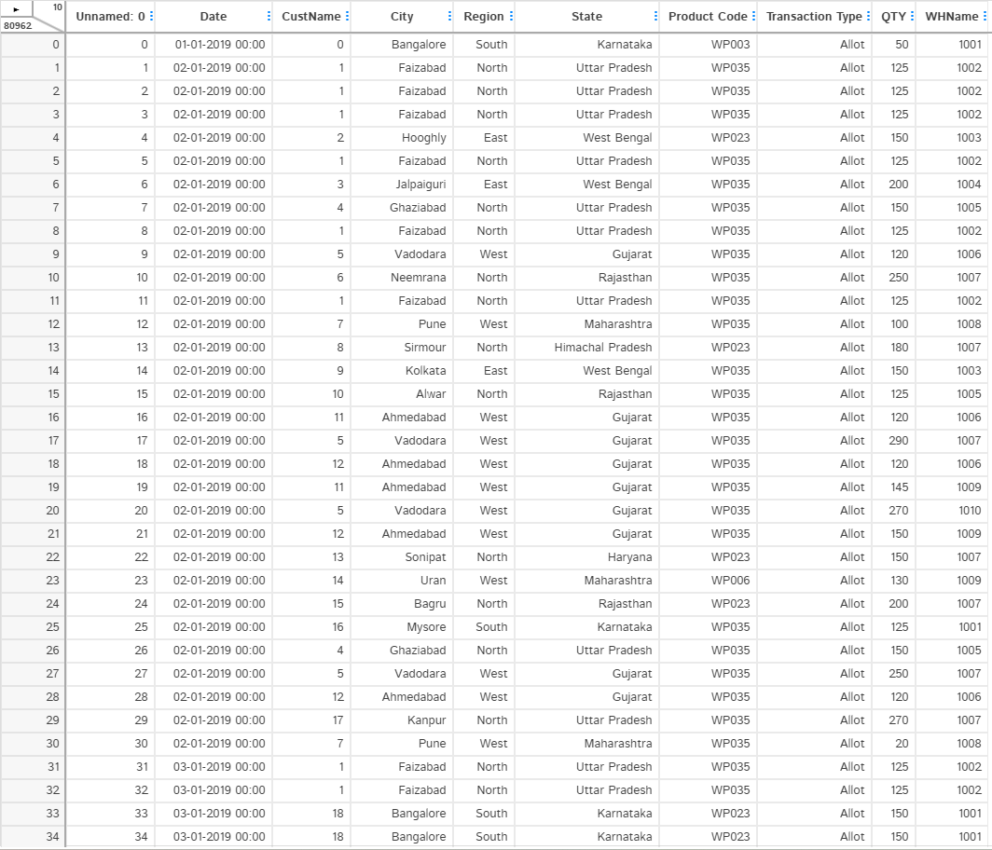
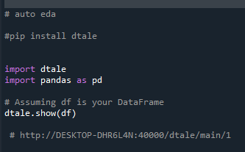
AUTO EDA
1. D-TALE
D-Tale is a Python library that provides a web-based graphical user interface (GUI) for exploratory data analysis (EDA). It allows users to interactively explore and visualize datasets, making it easier to gain insights into the data's characteristics, patterns, and potential issues. D-Tale is particularly useful for those who prefer a point-and-click interface for data analysis.
Coding:
Notes:
EDA is used for seeing what the data can tell us before the modeling task.
Change

Slide 23
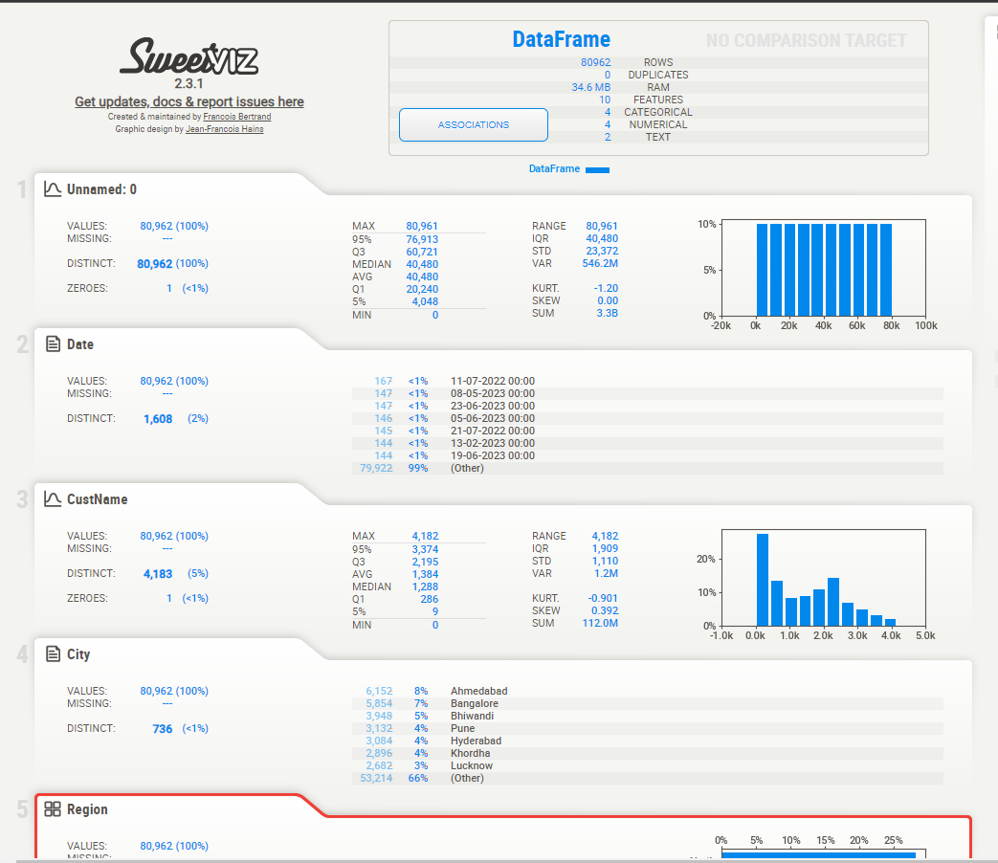
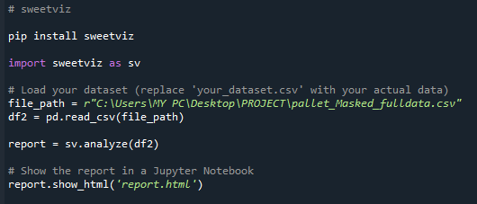
AUTO EDA
2. SWEET VIZ
Sweetviz is a Python library for visualizing and comparing datasets with a focus on simplicity and automation. It provides high-density visualizations to help users understand the structure and characteristics of their data quickly. Sweetviz is particularly useful for exploratory data analysis (EDA) and can generate detailed comparison reports for two datasets.
Coding:
Notes:
EDA is used for seeing what the data can tell us before the modeling task.
Change

Slide 24
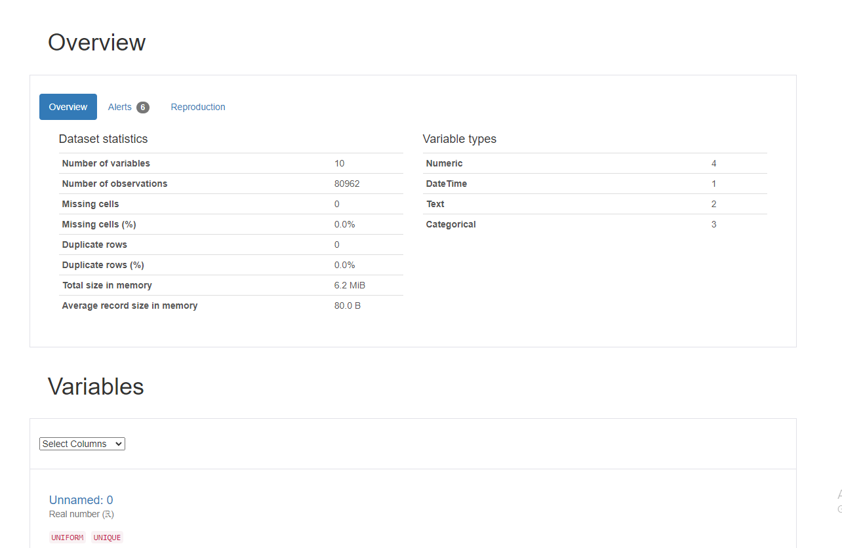
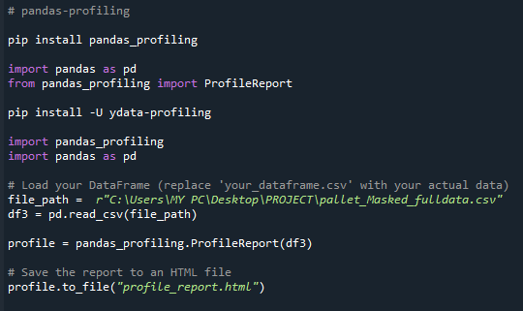
AUTO EDA
3. PANDAS PROFILLING
Pandas Profiling is a Python library that generates a comprehensive exploratory data analysis (EDA) report for a given Pandas DataFrame. The report includes information on the dataset's structure, statistical summaries, visualizations, and insights. Pandas Profiling aims to automate the initial steps of data analysis, providing users with a quick overview of their data.
Coding:
Notes:
EDA is used for seeing what the data can tell us before the modeling task.
Change

Slide 25
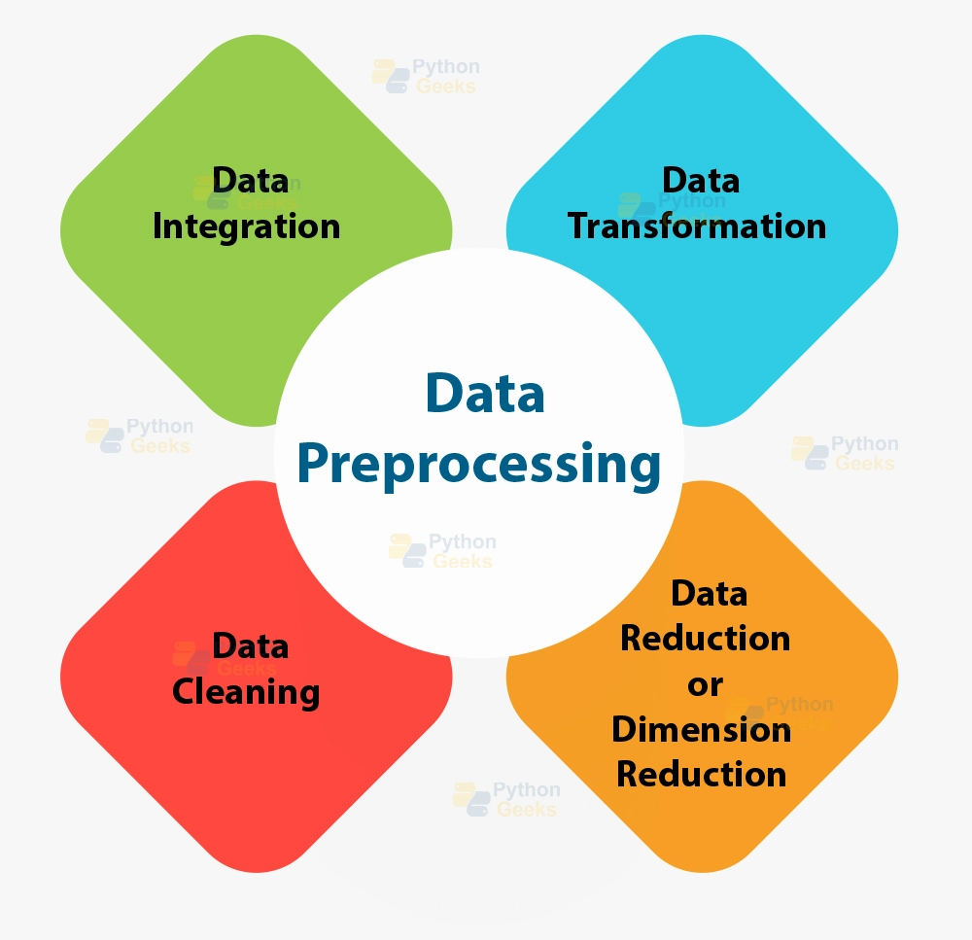
DATA PREPROCESSING
Data pre processing in Python involves a series of steps to clean, transform, and prepare the data for analysis or machine learning
The common pre processing tasks perform in this dataset are:
1.Handling Missing Values
2.Handling Outliers
3.Handling Null Values
4.Handlling Duplicate Values
Notes:
Keep observations

Slide 26
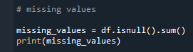
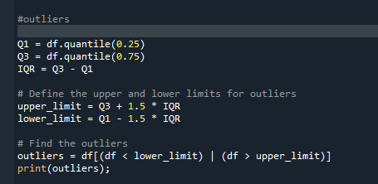
DATA PREPROCESSING
1. HANDLING MISSING VALUES
Handling missing values is a common task in data analysis and machine learning. In Python, there are several libraries and techniques you can use to deal with missing values.
Coding:
2. HANDLING OUTLIER VALUES
Outliers are data points that deviate significantly from the rest of the data, and they can have a substantial impact on statistical analysis and machine learning models.
Coding:

Slide 27
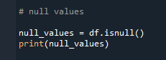
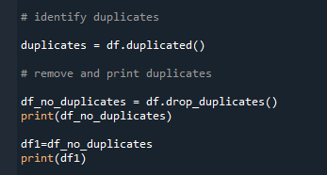
DATA PREPROCESSING
3. HANDLING NULL VALUES
Handling null values, also known as missing values, is a crucial step in data preprocessing.
Coding:
4. HANDLING DUPLICATE VALUES
Dealing with duplicate values is another important aspect of data pre processing. Duplicate values can affect the integrity of your analysis and models.
Coding:

Slide 28
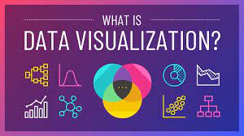
DATA VISUALIZATION
Data visualization is a powerful way to explore and communicate patterns, trends, and insights in your data. In Python, the popular libraries for data visualization are Matplotlib, Seaborn, and Plotly.
Type of Charts used in this dataset are:
Box Chart
Bar Chart
Histogram Chart
Scatter Chart
Pair Chart
Line Chart
Notes:
Add graphical

Slide 29
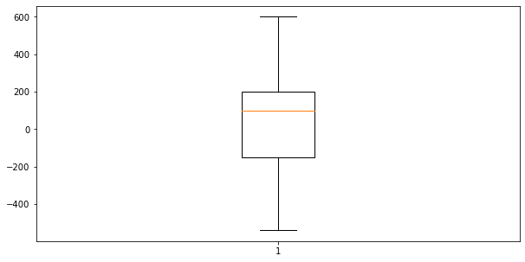
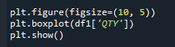
DATA VISUALIZATION
1. BOX CHART
A box plot is a statistical representation of the distribution of a dataset, showing the median, quartiles, and potential outliers.
QTY
Coding:
THERE ARE NO OUTLIERS ARE PRESENT
THE MEDIAN IS ABOVE THE 0(Q2) POINT
BOX CHART IS ONLY USED FOR SINGLE VARIABLE OR UNIVARIATE
Notes:
Add graphical

Slide 30
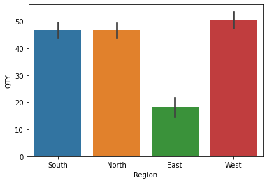

DATA VISUALIZATION
REGION AND QTY
2. BAR CHART
A bar chart is a common type of chart that presents categorical data with rectangular bars. Each bar's length or height is proportional to the values it represents. Bar charts are useful for comparing the quantities of different categories or for showing the distribution of a single categorical variable.
REGION AND QTY
Coding:
THERE ARE FOUR REGIONS (SOUTH ,NORTH, EAST,WEST)
THE QTY IN THE WEST IS MOST THAN THE REST OF ALL REGIONS
THE QTY IN EAST IS THE LOWEST AMONG THE OTHER REGIONS
THE SOUTH AND NORTH REGIONS ARE AMONG THE SAME QTY
Notes:
Add graphical

Slide 31
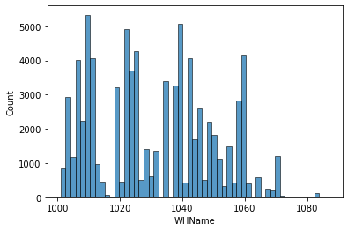
DATA VISUALIZATION
3. HISTOGRAM CHART
A histogram is a graphical representation of the distribution of a dataset. It shows the frequency of data points falling within specified ranges (bins). Histograms are commonly used to visualize the underlying probability distribution of a continuous variable.
WHNAME
Coding:
THE WAREHOUSE OF 1020-1040 ARE THE HIGHEST USE WAREHOUSE
THE WAREHOUSE FROM 1000-1020 ARE SAME AMOUNT AS THE WAREHOUSE BETWEEN 1020-1040
THE WAREHOUSE 1060-1080 ARE THE LOWEST USE
THE WAREHOUSE BETWEEN 1040-1060 ARE THE MODERATE USE
Notes:
Add graphical

Slide 32
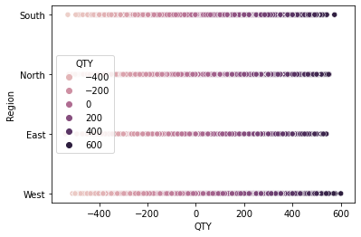
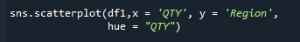
DATA VISUALIZATION
4. SCATTER CHART
A pair plot, also known as a scatterplot matrix, is a grid of scatterplots that shows the relationships between pairs of variables in a dataset. It's a powerful visualization tool for exploring multivariate relationships and identifying patterns.
QTY AND REGION
Coding:
EACH REGION HAVE LESS QTY OF PRODUCTS BUT THE WEST IS THE MOST HIGHEST NUMBER OF QTY , NORTH AND SOUTH ARE SAME
EAST IS THE LOWEST NO OF QTY
Notes:
Add graphical

Slide 33
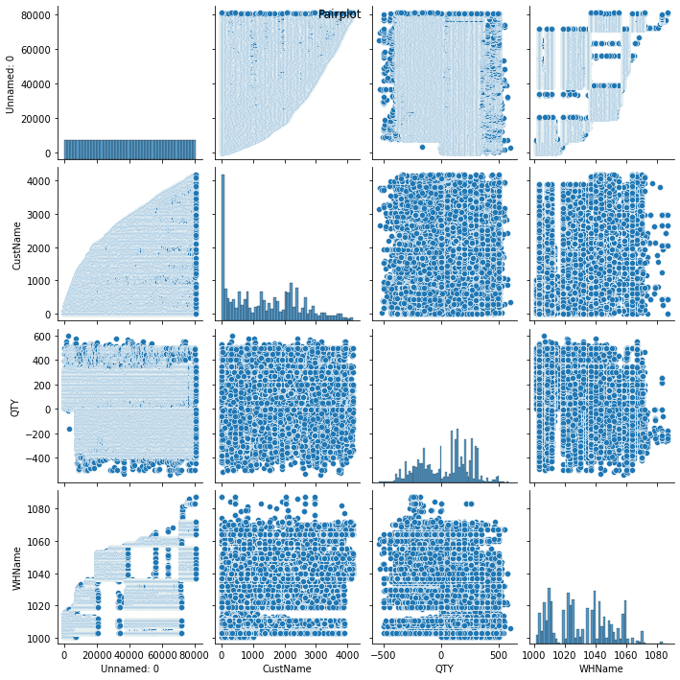
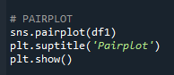
DATA VISUALIZATION
5. PAIR CHART
A pair plot, also known as a scatterplot matrix, is a grid of scatterplots that shows the relationships between pairs of variables in a dataset. It's a powerful visualization tool for exploring multivariate relationships and identifying patterns.
Coding:
IT CONSIST OF SCATTER AND HISTOGRAM CHART OF INTERGER DATA TYPER
Notes:
Add graphical

Slide 34
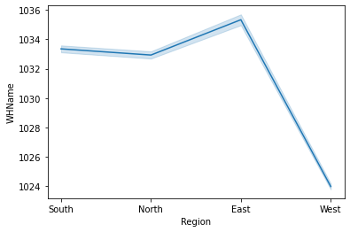
DATA VISUALIZATION
6. LINE CHART
A line chart is a type of chart that displays data points connected by straight line segments. It is often used to visualize the trends or patterns in time-series data or to show the relationship between two continuous variables
REGION AND WHNAME
Coding:
THE FIG IS BASED ON THE REGION AND WAREHOUSE
THE LINE HAS BEEN RAISED UP AND THEN A DOWNFALL
THE SOUTH AND NORTH REGION IS MOSTLY USES THE WAREHOUSE BETWEEN 1032-1034
THE EAST REGION USED THE 1036 WAREHOUSE
THE WEST REGION USED THE 1024 MAINLY
Notes:
Add graphical

Slide 35

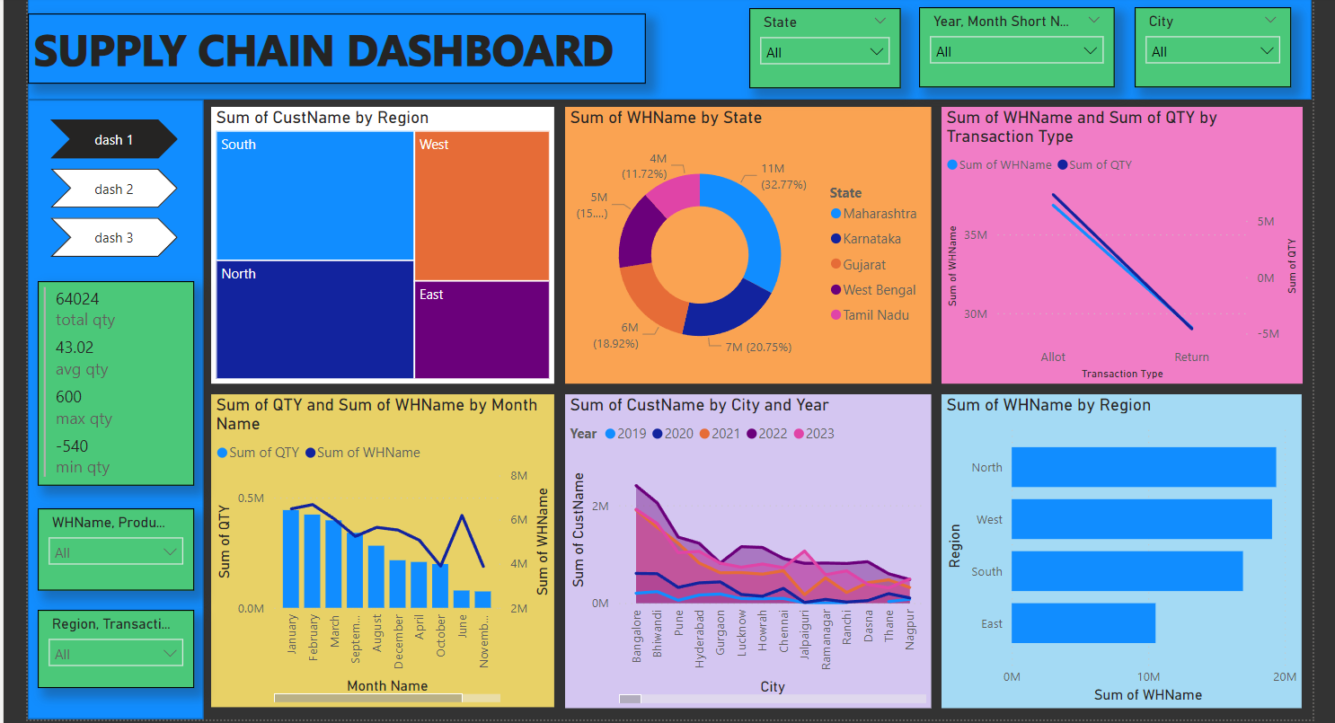
POWER BI DASHBOARD

Slide 36
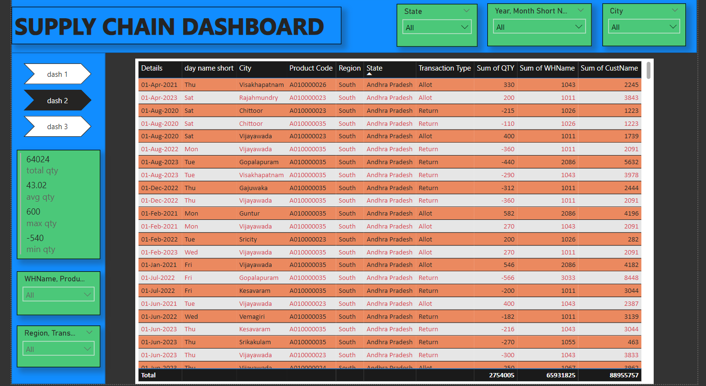
POWER BI DASHBOARD

Slide 37
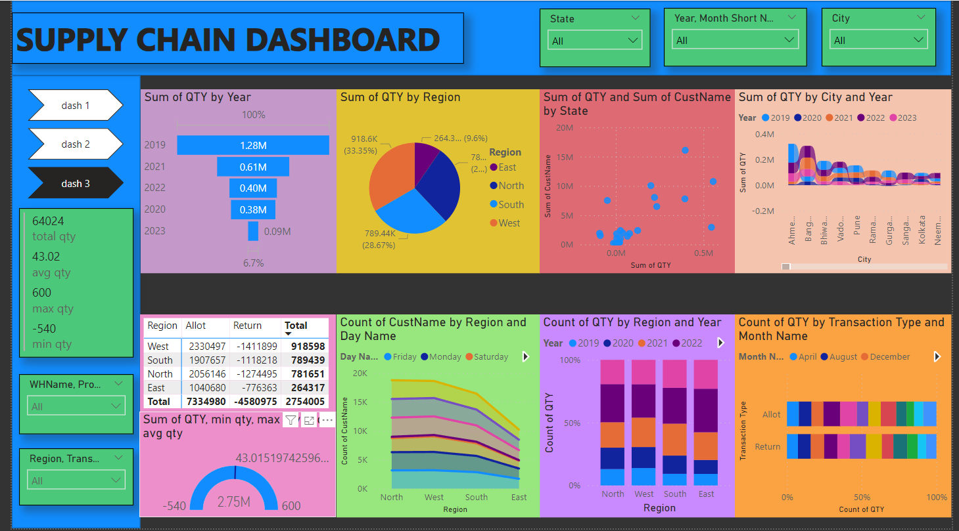
POWER BI DASHBOARD

Slide 38

POWER BI INSIGHTS
SUM OF CUSTNAME BY REGION
TREE MAP
EAST REGION IS THE LOWEST CUSTOMER
NORTH REGION HAS THE HIGHEST CUSTOMER
WE CAN IMPROVE THE CUSTOMER IN THE EAST REGION
SUM OF WHNAME BY REGION
BAR CHART
EAST REGION HAS THE LOWEST WAREHOUSE
NORTH REGION HAS THE HIGHEST WAREHOUSE
WE CAN IMPROVE THE WAREHOUSE NUMBER IN EAST REGION
SUM OF WHNAME & SUM OF QTR BY TRANSACTION TYPE
LINE CHART
THE WAREHOUSE AND QTY HAVE MORE ALLOT TYPE AND DECREASED TO RETURN TYPE
THAT MEANS THE QTY IN THE WAREHOUSE HAVE MORE ALLOT THAN RETURN
SUM OF QTY BY REGION
PIE CHART
THE EAST REGION IS THE LOWEST QTY OF 243K OF 9.6%
THE WEST REGION IS THE HIGHEST QTY OF 918.6K OF 33.3%
THEN WE CAN INCREASE THE QTY IN EAST REGION
SUM OF QTY BY YEAR
FUNNEL CHART
2023 IS THE LOWEST QTY OF ALL OF 0.09M (6.7%) 2019 IS THE HIGHEST QTY OF ALL OF 1.28M (100%)
THE UPCOMING YEAR CAN BE INCRESE THE QTY IN EACH WAREHOUSE
SUM OF QTY BY TRANSACTION TYPE BY MONTH NAME
STACKED BAR CHART
IN RETURN TYPE , JULY IS THE HIGHEST RETURN AND OCTOBER IS THE LOWEST RETURN
IN ALLOT TYPE , FEBRUARY IS THE HIGHEST ALLOT AND OCTOBER IS THE LOWEST ALLOT
FROM THIS OCTOBER IS THE MONTH WITH THE LOWEST QTY ALLOT AND RETURN OF PRODUCT

Slide 39

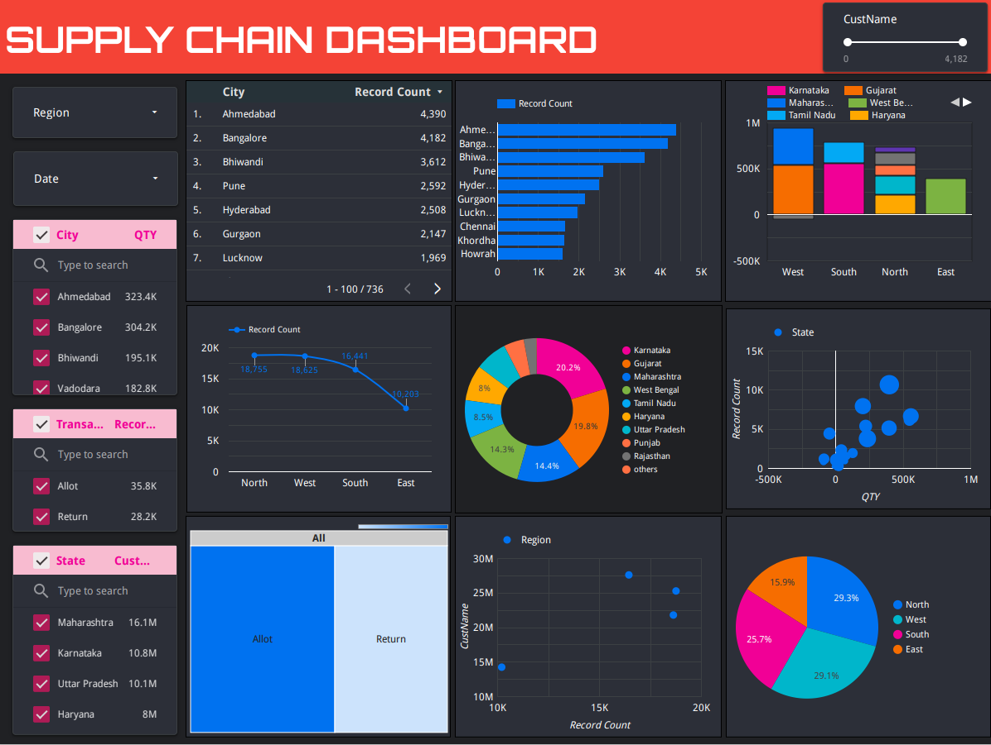
GOOGLE DATA STUDIO DASHBOARD

Slide 40
GOOGLE DATA STUDIO INSIGHTS
SUM OF CUSTNAME BY STATE
BUBBLE CHART
TRIPURA,CHATTISGARH,PONDICHERY IS THE LOWEST QTY AND LOWEST CUSTNAME BY THE STATE
THE MAHARASTRA,KARNATAKA,GUJARAT,WESTBENGAL,TAMIILNADU IS THE HIGHEST CUSTNAME AND QTY BY THEN STATE
WE CAN IMPROVE THE QTY IN THE LOWEST REGION , AND INCREASE THE CUSTOMERS
SUM OF CITY BY COUNT
STACKED BAR CHART
AHEDABAD IS THE HIGHEST CITY COUNT OF 4390
BANGALORE IS THE SECOND HIGHEST CITY COUNT OF 4182
BHIWANDI IS THE THIRD HIGHEST CITY COUNT OF 3612
HOWRAH.KHORDHA IS THE LOWEST CITY COUNT OF 1608
SUM OF QTY OF STATE BY REGION
STACKED COLUMN CHART
IN WEST REGION GUJARAT AND MAHARASTRA ARE THE HIGHEST NO OF QTY
IN EAST REGION WEST BENGAL IS THE HIGHEST NO OF QTY
IN SOUTH TAMILNADU AND KARNATAKA ARE THE HIEST NO OF QTY
IN NORTH UTTARKHAND,UTTARPRADESH,PUNJAB, HARYANA,RAJASTHAN ARE THE HIGHEST NO OF QTY
SUM OF QTR , STATE, TRANSACTION TYPE,REGION,CITY,
TABLE CHART
IN THIS CHART WE ACCUMULATE ALL THE DATAS INTO ONE SINGLE TABLE AND RECORD THE COUNT VALUES WHERE THE AHMEDABAD IS THE HIGHEST RECORD COUNT VALUE IN THE TABLE CHART AND JHARKHAND IS THE LOWEST RECORD COUNT VALUE
SUM OF CUSTNAME BY REGION
LINE CHART
THE NORTH REGION HAS THE HIGHEST CUSTOMER OF 18755
THE SOUTH REGION HAS THE HIGHEST CUSTOMER OF 16441
THE WEST REGION HAS THE HIGHEST CUSTOMER OF 18625
THE EAST REGION HAS THE HIGHEST CUSTOMER OF 10203
SUM OF QTY BY REGION
PIE CHART
THE EAST REGION IS THE LOWEST QTY OF 243K OF 9.6%
THE WEST REGION IS THE HIGHEST QTY OF 918.6K OF 33.3%
THEN WE CAN INCREASE THE QTY IN EAST REGION
SUM OF QTY BY TRANSACTION TYPE
TREE MAP
THE SUM OF QTY IN ALLOT TYPE IS 35848
THE SUM OF QTY IN RETURN TYPE IS 28176

Slide 41
CHALLENGES
Standardization Issues:
Lack of standardization in pallet types and sizes across industries and regions can lead to inefficiencies in handling and storage.
Pallet Damage and Durability:
Pallets are subject to wear and tear during transportation and handling, leading to damage. Ensuring the durability of pallets is a challenge, especially in industries with heavy or irregularly shaped loads.
Limited Visibility and Traceability:
Inadequate tracking and visibility into pallet movement throughout the supply chain can result in loss, theft, or misplaced pallets, impacting efficiency and inventory accuracy.
Pallet Lifecycle Management:
Managing the entire lifecycle of pallets, including maintenance, repair, refurbishment, and disposal, can be complex and resource-intensive.
Resistance to Change:
Resistance from stakeholders within the supply chain to adopt new pallet management practices or technologies may hinder optimization efforts.

Slide 42
CHALLENGES
Pallet Pooling Challenges:
Coordinating pallet pooling among multiple supply chain partners may be challenging due to differences in systems, processes, and business models.
Pricing and Cost Considerations:
Balancing the cost of implementing advanced pallet technologies with the potential benefits and ROI can be a challenge, especially for smaller businesses with budget constraints.
Data Security and Privacy:
Ensuring the security and privacy of data collected from smart pallets, especially when using IoT and sensor technologies, is crucial to prevent unauthorized access or data breaches.
Global Logistics Challenges:
Dealing with the complexities of international logistics, customs regulations, and varying transportation infrastructure when managing pallets on a global scale.

Slide 43
FUTURE SCOPE
The future scope of optimization in supply chain management, particularly focusing on pallets, is evolving with advancements in technology and a growing emphasis on sustainability, efficiency, and visibility.
Smart Pallets with IoT Integration:
Integration of Internet of Things (IoT) devices into pallets for real-time tracking, monitoring, and data collection.
Blockchain for Pallet Traceability:
Implementation of blockchain technology to enhance traceability and transparency in the movement of pallets across the supply chain.
Sustainable Pallet Materials and Designs:
Continued focus on sustainability with the use of eco-friendly materials in pallet manufacturing.
Innovative pallet designs that optimize material usage, durability, and recyclability.
Autonomous Pallet Handling Systems:
Integration of autonomous technologies for pallet handling within warehouses and distribution centers.
Automated guided vehicles (AGVs) and robotic systems for efficient pallet movement, reducing manual handling.
Data Analytics for Pallet Optimization:
Utilization of data analytics to analyze historical usage patterns and optimize pallet inventories.
Predictive analytics for demand forecasting, ensuring the right number of pallets at the right locations.

Slide 44
FUTURE SCOPE
Pallet Security Enhancements:
Integration of advanced security features, such as RFID technology, to prevent theft and unauthorized use.
Collaborative Pallet Management Platforms:
Development of collaborative platforms that facilitate communication and coordination among different stakeholders in pallet management.
Circular Economy Practices for Pallets:
Adoption of circular economy principles, encouraging pallet recycling, refurbishing, and reuse.
Pallet life cycle management practices to minimize waste and environmental impact.
3D Printing for Customized Pallet Solutions:
Exploration of 3D printing technologies to create customized, on-demand pallet solutions to specific supply chain requirements.
Rapid prototyping and production of pallets with optimized designs.
Predictive Maintenance for Pallets:
Implementation of predictive maintenance strategies for pallets, using sensor data to anticipate issues and reduce downtime.
Condition monitoring for early detection of wear and tear, leading to proactive maintenance.

Slide 45


